Slide 1
Arpeggiator
Notes:
c17593531

Slide 2
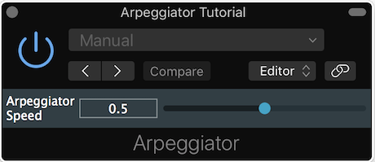
Arpeggiator
Chord: any harmonic set of pitches/frequencies consisting of multiple notes played together
Broken chord: notes overlap, but not played together
Arpeggio is chord played one note at a time
Arpeggiator
Common MIDI plugin that can be inserted on software instrument or MIDI track in DAW to modify incoming MIDI signals
Turns midi input chords into arpeggio
No audio processing

Slide 3
Implementation
define private member variables in pluginprocessor.h to implement arpeggiator
SortedSet object holds set of unique int variables according to sorting rule
Allows us to reorder MIDI notes efficiently to produce desired musical patterns
In class constructor
initialise plugin without audio bus
add parameter for arpeggiator speed
private:
juce::AudioParameterFloat* speed;
int currentNote, lastNoteValue;
int time;
float rate;
juce::SortedSet<int> notes;
NewProjectAudioProcessor::NewProjectAudioProcessor() : AudioProcessor (BusesProperties())
{
addParameter(speed = new juce::AudioParameterFloat({"speed",1}, "Arpeggiator speed",
0.0, 1.0, 0.5));
}
Notes:
create a new MidiBuffer object called processedMidi and append our modified MIDI signals to this new buffer before swapping it with the original at the end (this avoids direct modification problems).

Slide 4
prepareToPlay
initialise variables to prepare for subsequent processing
First, empty SortedSet of MIDI note numbers
currentNote temporarily holds current index for SortedSet of notes
lastNoteValue temporarily holds previous index to be able to stop note
time keeps track of note duration with respect to buffer size and sample rate
rate stores current sample rate in a float variable
void NewProjectAudioProcessor::prepareToPlay (double sampleRate, int samplesPerBlock)
{
notes.clear();
currentNote = 0;
lastNoteValue = -1;
time = 0;
rate = static_cast<float> (sampleRate);
}
Notes:
create a new MidiBuffer object called processedMidi and append our modified MIDI signals to this new buffer before swapping it with the original at the end (this avoids direct modification problems).

Slide 5
processBlock
check it’s MIDI plugin
get # samples in block from audio buffer
void NewProjectAudioProcessor::processBlock (juce::AudioBuffer<float>& buffer, juce::MidiBuffer& midi)
{
// A pure MIDI plugin shouldn't be provided any audio data
jassert(buffer.getNumChannels() == 0);
// however we use the buffer to get timing information
auto numSamples = buffer.getNumSamples();
// get note duration
auto noteDuration = static_cast<int> (std::ceil(rate * 0.25f * (0.1f + 1.0f-(*speed))));
for (const auto metadata : midi) {
const auto msg = metadata.getMessage();
if (msg.isNoteOn()) notes.add(msg.getNoteNumber());
else if (msg.isNoteOff()) notes.removeValue(msg.getNoteNumber());
}
midi.clear();
get note duration in samples from sample rate & speed
For all events in MidiBuffer, add note to SortedSet if Note On remove if Note Off
Empty MidiBuffer to add single notes back in buffer one by one next
Notes:
create a new MidiBuffer object called processedMidi and append our modified MIDI signals to this new buffer before swapping it with the original at the end (this avoids direct modification problems).

Slide 6
processBlock
note transition in block if current time + # samples in block > note duration, so modify MidiBuffer. Otherwise keep MIDI state as is.
Calculate sample offset within current block where note transition occurs
If previous note still playing, lastNoteValue >0 so Note Off event to stop note with correct sample offset. Then reset lastNoteValue
If notes to play in SortedSet, retrieve next note number, store last note number & send Note On to play first note
…
if ((time + numSamples) >= noteDuration) {
auto offset = juce::jmax(0, juce::jmin((int)(noteDuration - time), numSamples - 1));
if (lastNoteValue > 0) {
midi.addEvent(juce::MidiMessage::noteOff(1, lastNoteValue), offset);
lastNoteValue = -1;
}
if (notes.size() > 0) {
currentNote = (currentNote + 1) % notes.size();
lastNoteValue = notes[currentNote];
midi.addEvent(juce::MidiMessage::noteOn(1, lastNoteValue, (juce::uint8)127), offset);
}
}
time = (time + numSamples) % noteDuration;
}
Keep track of current time relative to note duration
Notes:
create a new MidiBuffer object called processedMidi and append our modified MIDI signals to this new buffer before swapping it with the original at the end (this avoids direct modification problems).

Slide 7
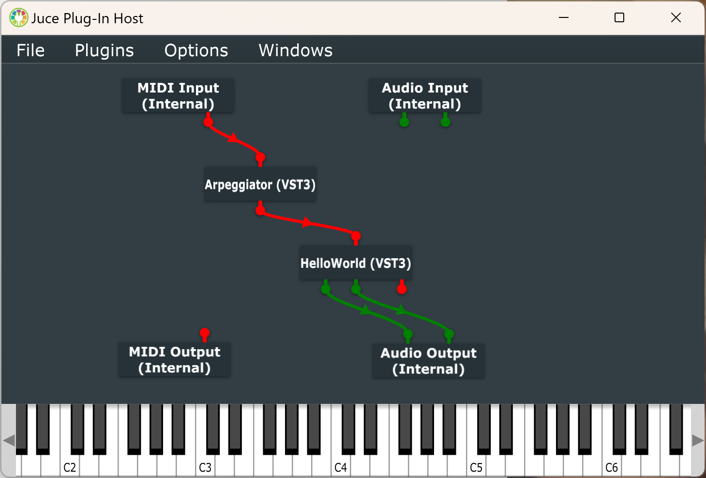
Chaining midi effect and instrument
Now use the arpeggiator as a midi effect, processing midi input before rendering it with the HelloWorld synthesiser we created

